Slide 1

Global Monetary System
UNIT 3

Slide 2
Learning Objectives
his topic helps students understand how the international financial system operates and how global institutions support economic development and financial stability.
After studying this topic, students will be able to:
• Explain the concept of the global monetary system • Understand the functioning of the foreign exchange market • Identify the role of international financial institutions • Analyze the importance of IMF, World Bank, and ADB

Slide 3

Global Monetary System
The global monetary system refers to the set of rules, institutions, and agreements that regulate international financial transactions and exchange rates between countries. It plays an important role in facilitating global trade and investment.
The system ensures that countries can conduct international payments and currency exchanges efficiently, which supports economic cooperation and financial stability worldwide.
Example: When an Indian company exports software services to the United States, the payment is made in US dollars and converted into Indian rupees through the global financial system

Slide 4

Introduction to Global Monetary System
The global monetary system is the international framework that governs how countries manage exchange rates and financial transactions across borders. It includes various institutions, policies, and agreements that regulate global financial relationships.
This system helps countries maintain stable exchange rates and manage international payments related to trade and investment.
Example: Companies engaged in international trade must convert their domestic currency into foreign currency to complete international transactions.

Slide 5

Meaning of Global Monetary System
The global monetary system refers to the network of international institutions, financial markets, and agreements that control currency exchange and international payments.
It ensures that countries can conduct trade smoothly by providing mechanisms for currency conversion and financial cooperation.
Example: When a German company imports electronic components from Japan, the payment must be made through international financial systems and currency exchange mechanisms.

Slide 6
Importance of Global Monetary System
Facilitates International Trade The global monetary system allows countries to exchange currencies and make international payments smoothly, which helps businesses trade goods and services across borders. Example: An Indian company exporting textiles to the United States receives payment in US dollars and converts it into Indian rupees.
Maintains Exchange Rate Stability It helps maintain stable exchange rates between different currencies, reducing uncertainty in international financial transactions. Example: Stable exchange rates help companies plan international investments and trade activities.
Promotes Global Economic Cooperation The system encourages cooperation between countries through international financial institutions and agreements. Example: Countries work together through organizations like the IMF to manage financial crises.
Supports International Investment Investors can invest in foreign countries with confidence because the global monetary system ensures reliable currency exchange and financial regulations. Example: Multinational companies invest in manufacturing plants in different countries.
Helps Manage Financial Crises International financial institutions provide financial support to countries experiencing economic difficulties. Example: The IMF provides loans to countries facing balance of payment problems.
Encourages Economic Growth By supporting international trade and investment, the global monetary system contributes to overall economic development and growth worldwide. Example: Developing countries receive financial assistance for development projects.

Slide 7

Foreign Exchange Market
The foreign exchange market, also known as the Forex market, is the global marketplace where currencies are bought and sold. It is the largest financial market in the world and operates 24 hours a day.
The foreign exchange market allows businesses and governments to exchange currencies for international trade and investment.
Example: An Indian company importing machinery from the United States must convert Indian rupees into US dollars.

Slide 8
Functions of Foreign Exchange Market
Currency Conversion The foreign exchange market helps convert one country's currency into another country's currency so that international trade and transactions can take place smoothly. Example: An Indian company importing machinery from the United States converts Indian rupees into US dollars to make the payment.
Determination of Exchange Rates The foreign exchange market determines the value of one currency relative to another based on demand and supply in the global market. Example: If the demand for US dollars increases, the value of the dollar rises compared to other currencies.
Facilitates International Trade and Investment It allows businesses and investors to transfer funds across countries for trade, investment, and other international transactions. Example: A multinational company investing in a factory in another country exchanges its domestic currency into the local currency.

Slide 9
Provides Liquidity The foreign exchange market ensures that currencies can be bought and sold easily at any time, making international financial transactions more efficient. Example: Banks and financial institutions exchange currencies quickly to support global business operations.
Hedging Against Exchange Rate Risk The foreign exchange market helps businesses protect themselves from fluctuations in currency values through financial instruments such as forward contracts and options. Example: An exporter may lock in a future exchange rate to avoid losses if the currency value changes

Slide 10
Participants in Foreign Exchange Market
Commercial Banks Commercial banks are the most active participants in the foreign exchange market. They buy and sell foreign currencies on behalf of their customers and also trade currencies for their own profit. Example: A bank helps a company convert Indian rupees into US dollars to pay for imported goods.
Central Banks Central banks participate in the foreign exchange market to control the supply of money and stabilize the value of their country's currency. They may buy or sell foreign currencies to influence exchange rates. Example: The Reserve Bank of India (RBI) may intervene in the foreign exchange market to stabilize the Indian rupee.
Multinational Corporations (MNCs) Large international companies participate in the foreign exchange market to conduct business transactions in different countries. They exchange currencies when importing raw materials or exporting products. Example: A company like Toyota converts earnings from different countries into its home currency.

Slide 11
Governments Governments participate in the foreign exchange market to manage national economic policies and international trade transactions. Example: Governments may exchange currencies when making international payments or receiving foreign aid.
Financial Institutions and Investment Firms Investment banks, hedge funds, and financial institutions trade currencies for investment purposes and profit. Example: Investment firms trade currencies to benefit from changes in exchange rates.
Individual Traders Individual investors also participate in the foreign exchange market through online trading platforms to earn profits from currency fluctuations. Example: A trader buying euros and selling them later when the value increases.

Slide 12
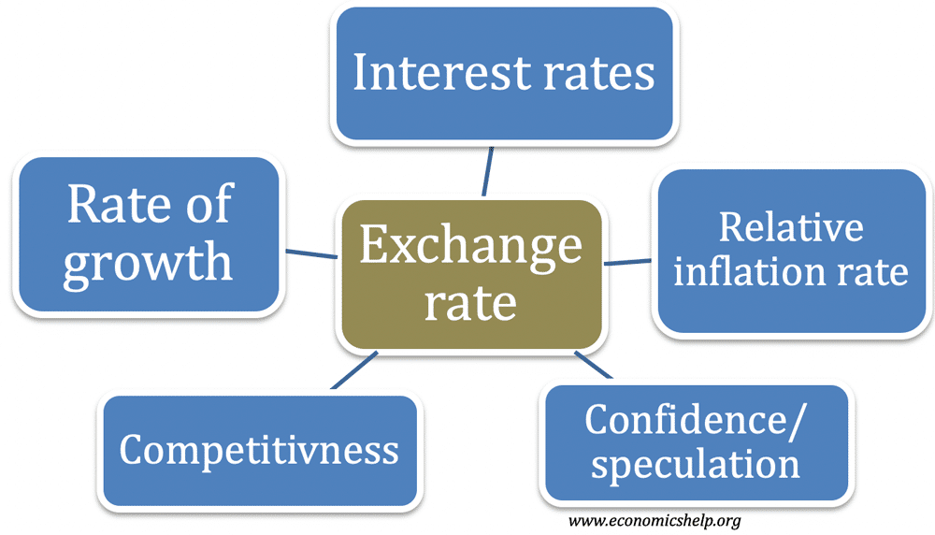
Exchange Rate
An exchange rate refers to the value of one country's currency in relation to another country's currency. Exchange rates influence international trade and investment decisions.
Exchange rates change due to factors such as inflation, interest rates, political stability, and economic performance.
Example: If 1 US Dollar equals 83 Indian Rupees, Indian importers must pay 83 rupees to buy one US dollar.

Slide 13
International Monetary System
The International Monetary System (IMS) refers to the set of rules, institutions, agreements, and financial arrangements that govern how countries manage their currencies and conduct international financial transactions. It helps regulate exchange rates, international payments, and the flow of capital between countries. The system ensures that countries can trade with one another smoothly by providing mechanisms for currency exchange and financial cooperation.
The international monetary system plays an important role in maintaining stability in global financial markets. It helps countries manage balance of payments, stabilize exchange rates, and promote international trade and investment. Institutions such as the International Monetary Fund (IMF) and the World Bank play an important role in supporting the international monetary system by providing financial assistance and policy guidance to countries.
Example: When a country faces a balance of payment crisis and needs financial assistance to stabilize its economy, it may seek support from the International Monetary Fund (IMF) as part of the international monetary system.

Slide 14
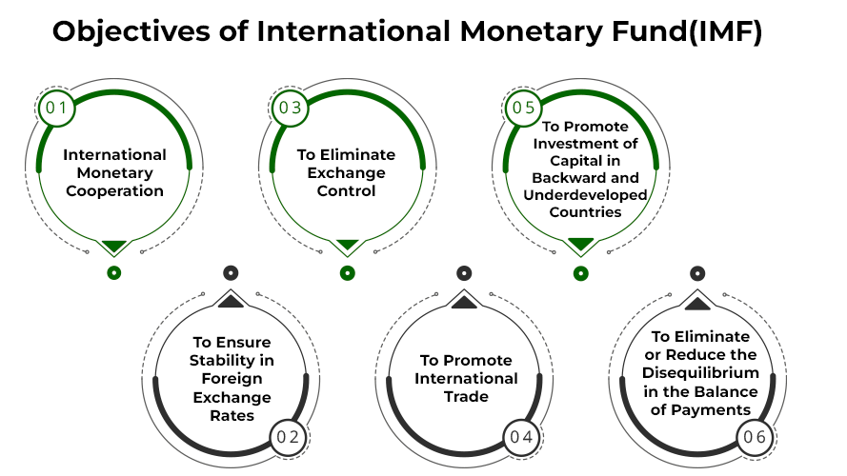
Objectives of International Monetary System
Maintain Exchange Rate Stability One of the main objectives of the international monetary system is to maintain stable exchange rates between currencies. Stable exchange rates reduce uncertainty in international trade and investment. Example: When exchange rates remain stable, businesses can plan international transactions without worrying about sudden currency fluctuations.
Promote International Trade The system aims to facilitate smooth and efficient international trade by providing mechanisms for currency exchange and international payments. Example: Companies importing or exporting goods can easily convert currencies through international financial systems.

Slide 15
Encourage Financial Cooperation Among Countries The international monetary system promotes cooperation between countries to maintain global economic stability and prevent financial crises. Example: Countries cooperate through organizations like the IMF to solve international financial problems.
Provide Financial Assistance During Economic Crises The system supports countries facing financial difficulties by providing financial assistance and economic guidance. Example: The IMF provides loans to countries experiencing balance of payment problems.
Ensure Efficient International Payments System It ensures that international payments between countries can be made quickly and securely. Example: Businesses transferring payments for international trade use international banking systems.

Slide 16
Evolution of International Monetary System
The International Monetary System (IMS) has evolved over time as countries developed different methods to manage exchange rates and international financial transactions. These changes were necessary to support growing international trade and maintain global financial stability. The evolution of the international monetary system can be understood through three major stages.
Gold Standard System Under the gold standard system, the value of each country's currency was directly linked to a fixed amount of gold. Countries maintained gold reserves, and currencies could be converted into gold at a fixed rate. This system helped maintain stable exchange rates between countries. Example: Before World War I, many countries such as the United Kingdom and the United States used the gold standard to determine the value of their currencies.
Bretton Woods System The Bretton Woods system was established in 1944 to create a stable international financial system after World War II. Under this system, currencies were linked to the US dollar, and the US dollar was convertible into gold. This system also led to the creation of international institutions such as the International Monetary Fund (IMF) and the World Bank. Example: Countries fixed their exchange rates relative to the US dollar to maintain stability in global trade.
Floating Exchange Rate System After the collapse of the Bretton Woods system in the 1970s, many countries adopted a floating exchange rate system. In this system, currency values are determined by market demand and supply rather than being fixed by governments. Example: Today, the value of currencies such as the Indian rupee or the euro changes according to global market conditions.

Slide 17
Objectives of IMF
Promote International Monetary Cooperation One of the main objectives of the IMF is to encourage cooperation among countries in international financial matters. It helps countries work together to maintain stability in the global financial system. Example: Countries consult the IMF when developing economic policies that affect global financial stability.
Maintain Exchange Rate Stability The IMF aims to maintain stable exchange rates between currencies to prevent sudden fluctuations that could disrupt international trade. Example: The IMF may advise countries on policies to stabilize their currency during financial instability.
Facilitate International Trade The IMF supports international trade by helping countries maintain stable financial systems and by reducing barriers related to currency exchange and payments. Example: Countries facing balance of payment problems receive financial support from the IMF to continue international trade.
Provide Financial Assistance to Member Countries The IMF provides loans and financial assistance to countries experiencing economic difficulties, especially balance of payment crises. Example: Countries facing financial crises may borrow funds from the IMF to stabilize their economy.
Promote Economic Growth and Stability The IMF works to improve economic stability and sustainable growth in member countries through financial support and economic policy guidance. Example: The IMF provides economic advice and financial programs to help developing countries strengthen their economies.

Slide 18

Functions of IMF
Provides Financial Assistance The IMF provides loans and financial support to member countries that face economic difficulties such as balance of payment problems or financial crises. This helps countries stabilize their economies and restore financial stability. Example: Countries facing severe financial crises may receive emergency loans from the IMF to stabilize their economy.
Monitors Global Economic Conditions The IMF regularly monitors the economic performance and financial policies of member countries to ensure stability in the global financial system. Example: The IMF reviews economic policies of countries and provides reports on global economic trends.
Promotes Exchange Rate Stability The IMF works to maintain stable exchange rates between currencies and prevents excessive fluctuations that may disrupt international trade. Example: The IMF may advise countries on policies to stabilize their currency value during economic instability.
Provides Technical Assistance and Training The IMF offers technical assistance, training programs, and expert advice to help countries improve their financial and economic management. Example: The IMF may help countries improve their banking systems and financial regulations.
Supports International Monetary Cooperation The IMF encourages cooperation among member countries to address global financial issues and maintain stability in the international monetary system. Example: Countries participate in IMF meetings to discuss global economic challenges and financial policies.

Slide 19

World Bank
The World Bank is an international financial institution that provides financial assistance and technical support to developing countries for economic development projects. It was established in 1944 during the Bretton Woods Conference with the main objective of reducing poverty and improving living standards around the world. The World Bank helps countries finance projects related to infrastructure, education, healthcare, agriculture, and environmental sustainability.
The World Bank plays an important role in supporting economic growth and development by providing loans, grants, and policy advice to developing countries. By funding development projects, the organization helps countries improve their economic conditions, create employment opportunities, and enhance the quality of life for their citizens.
Example: The World Bank provides financial support to developing countries for projects such as building roads, bridges, schools, hospitals, and water supply systems, which help improve infrastructure and economic development.

Slide 20

Asian Development Bank (ADB)
The Asian Development Bank (ADB) is a regional financial institution established in 1966 to promote economic growth and development in the Asia-Pacific region. Its main objective is to reduce poverty and improve the living standards of people in developing Asian countries. The ADB provides financial assistance, technical support, and policy advice to help countries develop infrastructure, improve economic stability, and promote sustainable development.
The Asian Development Bank supports various development projects such as transportation, energy, education, agriculture, and environmental protection. By providing loans, grants, and investment opportunities, the ADB helps developing countries strengthen their economies and improve social conditions.
Example: The Asian Development Bank provides financial assistance to Asian countries for projects such as building highways, improving public transportation systems, and developing renewable energy projects to support economic growth and infrastructure development.

Slide 21
Case Study: IMF Support During the Asian Financial Crisis (1997)
In 1997, several Asian countries such as Thailand, Indonesia, and South Korea faced a severe financial crisis known as the Asian Financial Crisis. The crisis began when Thailand’s currency, the Thai Baht, collapsed due to excessive foreign debt and weak financial systems. As the currency lost value, investors lost confidence, and many businesses and banks faced financial difficulties. The crisis quickly spread to other Asian countries, causing economic instability, unemployment, and reduced international trade.
To stabilize the situation, affected countries requested financial assistance from the International Monetary Fund (IMF). The IMF provided large financial packages along with economic reform programs to help restore stability. These programs included improving financial regulations, reducing government spending, and strengthening banking systems. Over time, these measures helped the countries recover from the crisis and rebuild investor confidence.
This case study shows how international financial institutions such as the IMF play an important role in maintaining global financial stability and supporting countries during economic crises. It also highlights the importance of strong financial systems and international cooperation in preventing financial instability.

Slide 22

Discussion Questions
What were the main causes of the Asian Financial Crisis in 1997?
How did the IMF help Asian countries recover from the financial crisis?
Why are international financial institutions important during economic crises?
What lessons can countries learn from the Asian Financial Crisis to prevent similar situations in the future?

Slide 23


